Slide 1
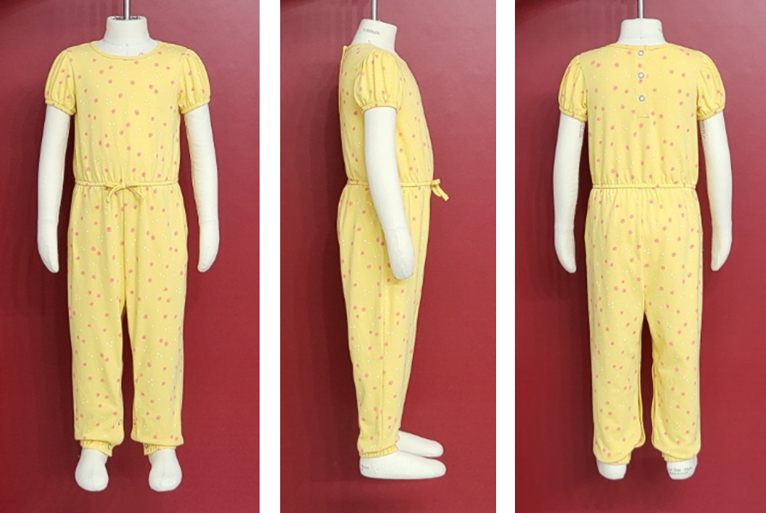
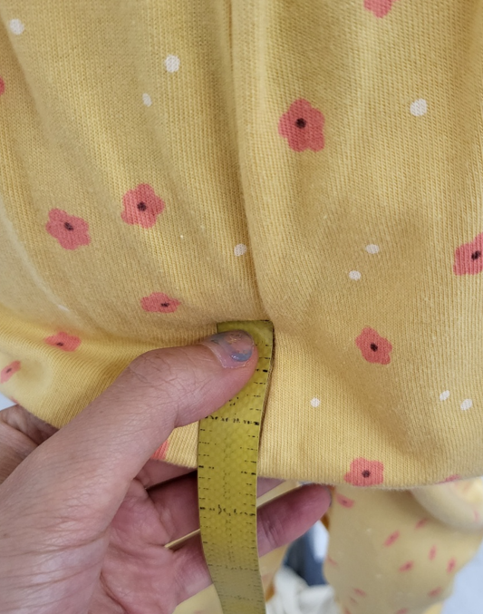
WP5M5 1st Prototype Page 1 of 3
BPFE digital
BPFE comments:
Fit and balance are good.
There’s no blouson and the rise ease is appx 3”~3.25”.
TGT TD Comments:
-Agree with all points.

Slide 2
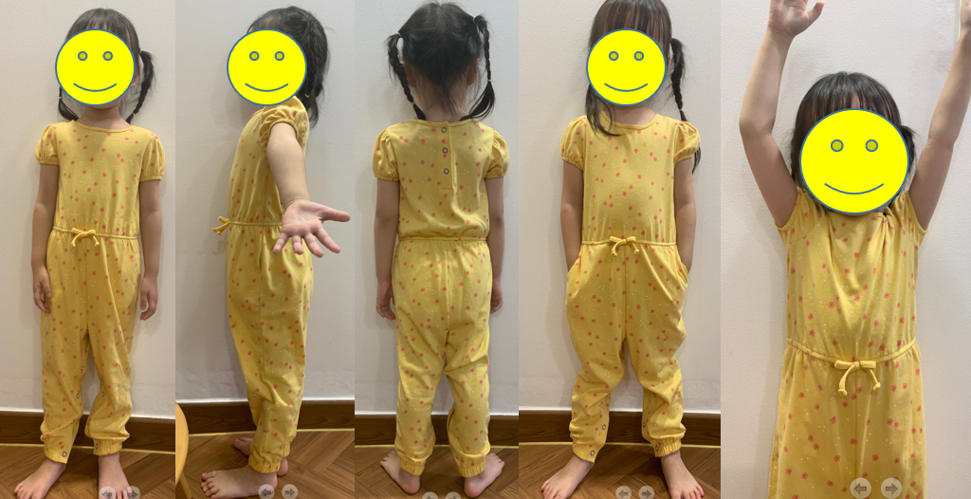
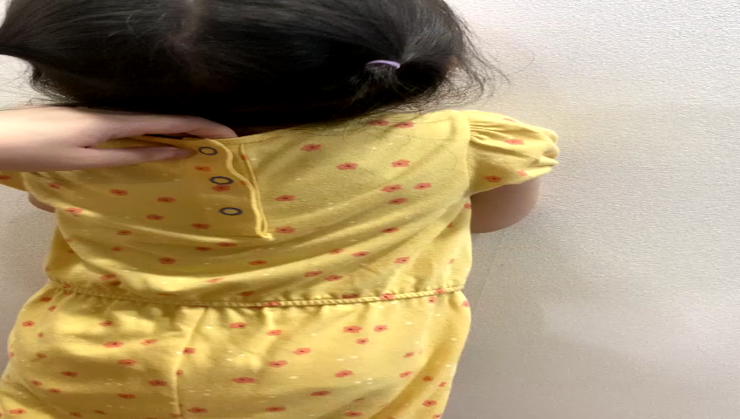
WP5M5 1st Prototype Page 2 of 3
Click the file to play ☺
BPFE comments:
Have checked the overall movement w/ the live model.
She felt comfortable with movement. Also, there was no restriction when putting on and taking off the garment.
The functional pocket is okay when putting the hands in pocket.
Snaps at CB NK and inseam placket works well.
TGT TD Comments:
Noted all points.

Slide 3
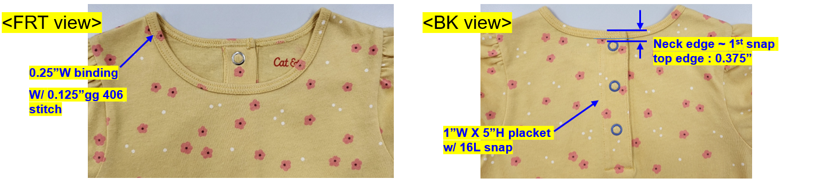
WP5M5 1st Prototype Page 3 of 3
Reviewed by BPFE Yoonie Lee :
We’ve made the fit sample as based on confirmed pre-fit sample. We’ve updated measurement and construction as based on fit sample.
According to confirmed thru DT, we’ve applied 1”W X 5”H placket w/ 3 snaps at CB NK for enough neck opening to pass over the hip ~ shoulder easily.
To applied the snap as close as possible at neck edge, we’ve applied 0.25”W neck binding. Also, we’ve applied clean top and raw bottom binding w/ 0.125”gg 406 stitch to reduce the thickness at CB NK placket top edge. Pls kindly review and confirm the CB NK placket construction.
TGT-TD Response to BP Comments:
-Noted all points.
TGT-TD Comments:
- Overall construction looks good.

